Slide 1
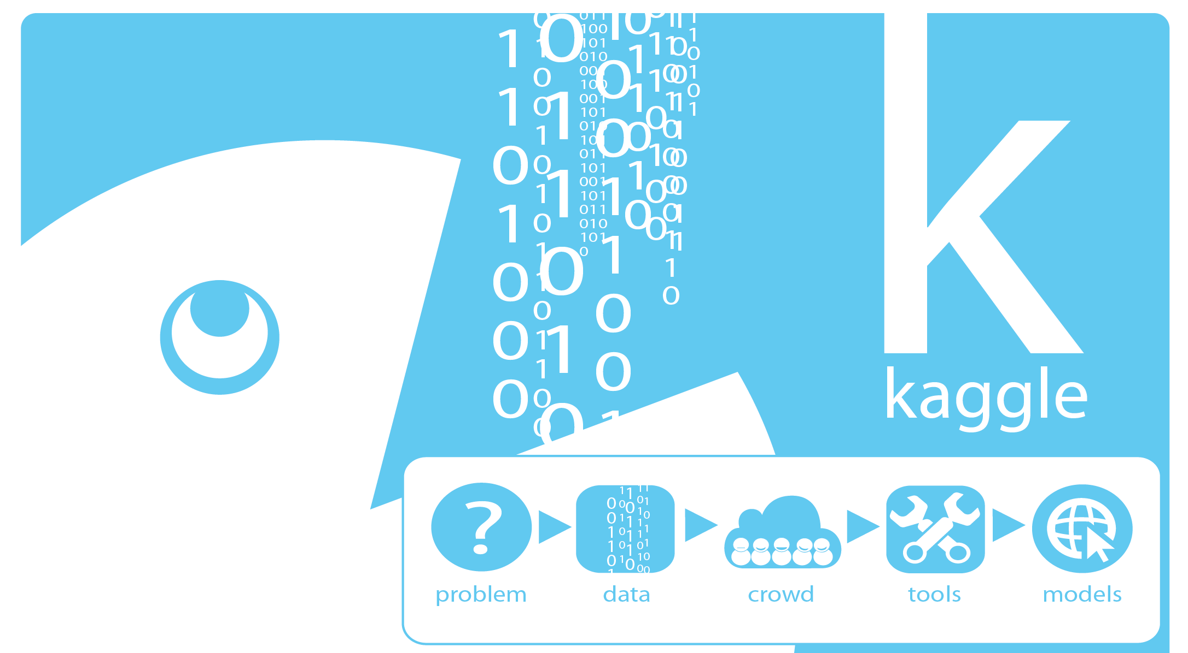
Learning from the Best -- Kaggle Best Practices
Image: http://www.36dsj.com/wp-content/uploads/2016/06/1510.jpg
Cork Big Data Analytics, 2015-08-15 Johannes Ahlmann

Slide 2
Disclaimer
Insights from Kaggle winners or near-winners
Data Analytics is a huge field, this can only be a small, Kaggle-specific view
Much of the structure is “borrowed” from David Kofoed Wind’s blog post and Thesis on Kaggle Best Practices

Slide 3
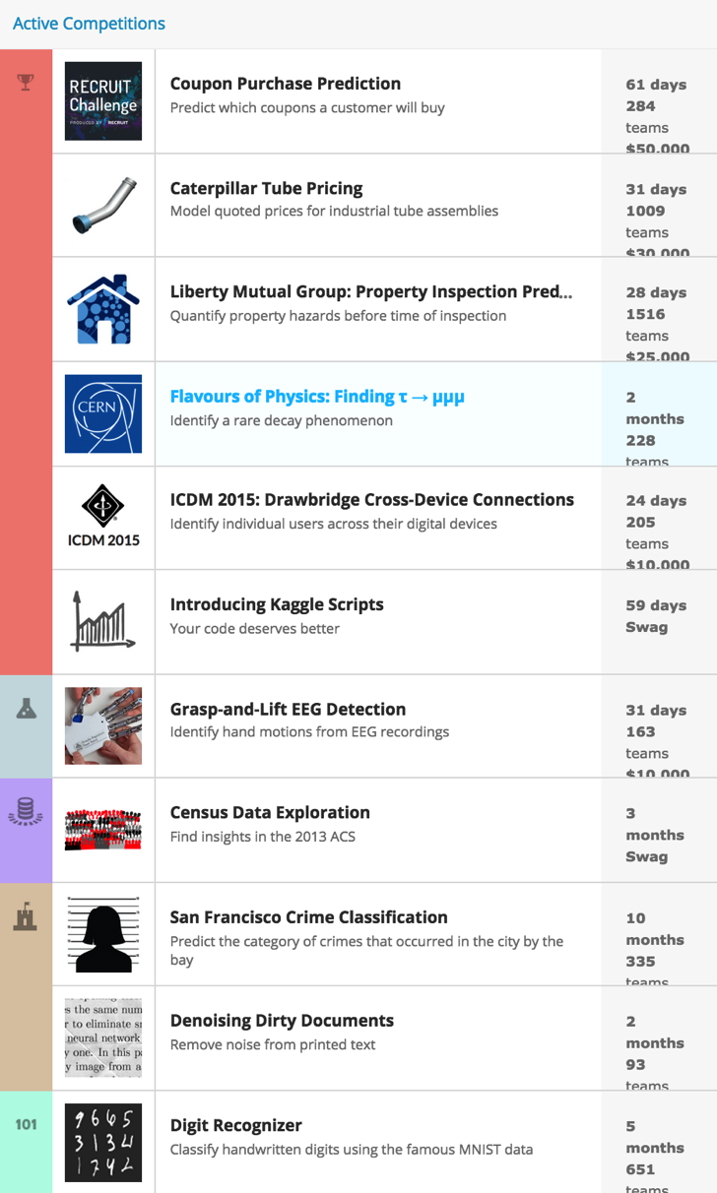
Kaggle
Platform for predictive modelling and analytics competitions
Open to anyone
“Crowdsourcing”
Automated scoring
Leaderboard
Public, private and competitions with awards

Slide 4
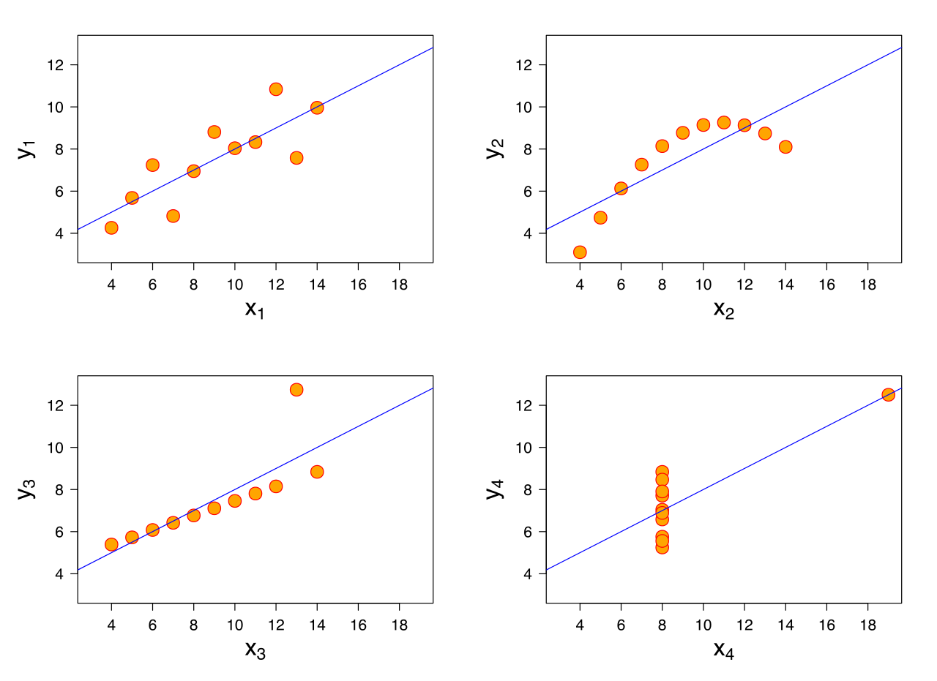
Don’t rely on simple Metrics
mean(x) = 9
mean(y) = 7.50
variance(x) = 11
variance(y) = 4.1
correlation = 0.816
lm = 3.00 + 0.500x
We need to remind ourselves; over and over again
It is so easy to become complacent!
Image: https://upload.wikimedia.org/wikipedia/commons/thumb/e/ec/Anscombe%27s_quartet_3.svg
Notes:
Anscombe’s Quartet

Slide 5
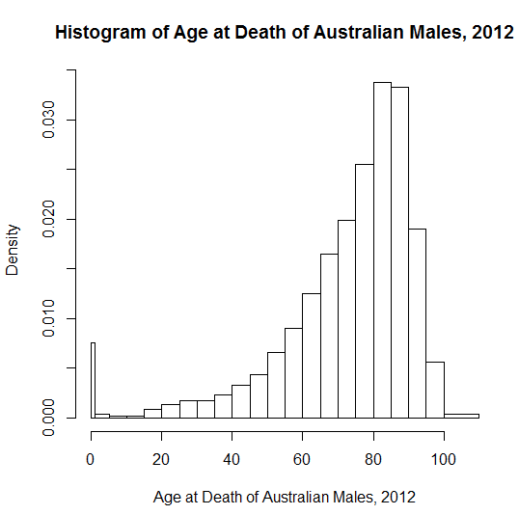
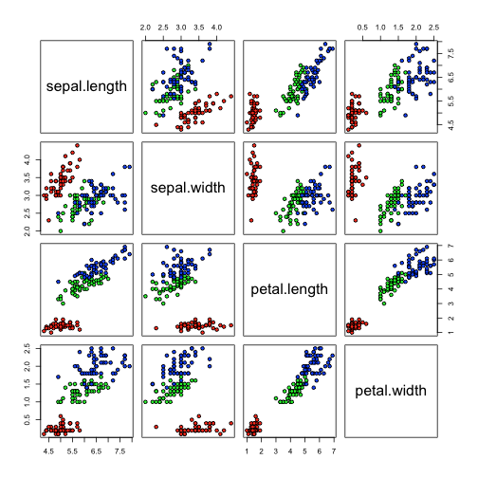
Get to know the Data
Visualize the Data
how can we visualize 5 dimensions? 2000?
simple metrics are not enough
start feature-by-feature, or pair-wise
Understand the Shape and Patterns of the Data
what do the attributes mean? how are they related?
skew
scale
factors (“man”, “woman”)
ordinals (“good”, “better”, “best”)
missing data, data inconsistencies
shape
“step-functions”
“outliers”?
structural differences between train and test set

Slide 6
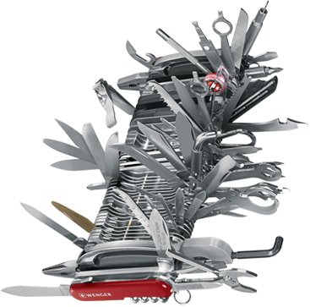
“Feature Engineering is the most important Part”
Most kagglers use same few algorithms (logistic regression, random forest, gbm)
Subject matter expertise often not a huge factor
Err on the side of too many features. Thousands of features usually not a problem
Examples
pairwise: a-b, a/b, a*b, 1/a, log(a), |a|
date => weekday, day of month, time
GPS locations => velocity, acceleration, angular acceleration, segment into stops, segment into accelerating and braking phases, mean/median/stddev/centiles/min/max, etc.
text => ngrams, tokenize, stemming, stopwords
Image: https://content.etilize.com/images/300/300/1017951585.jpg

Slide 7
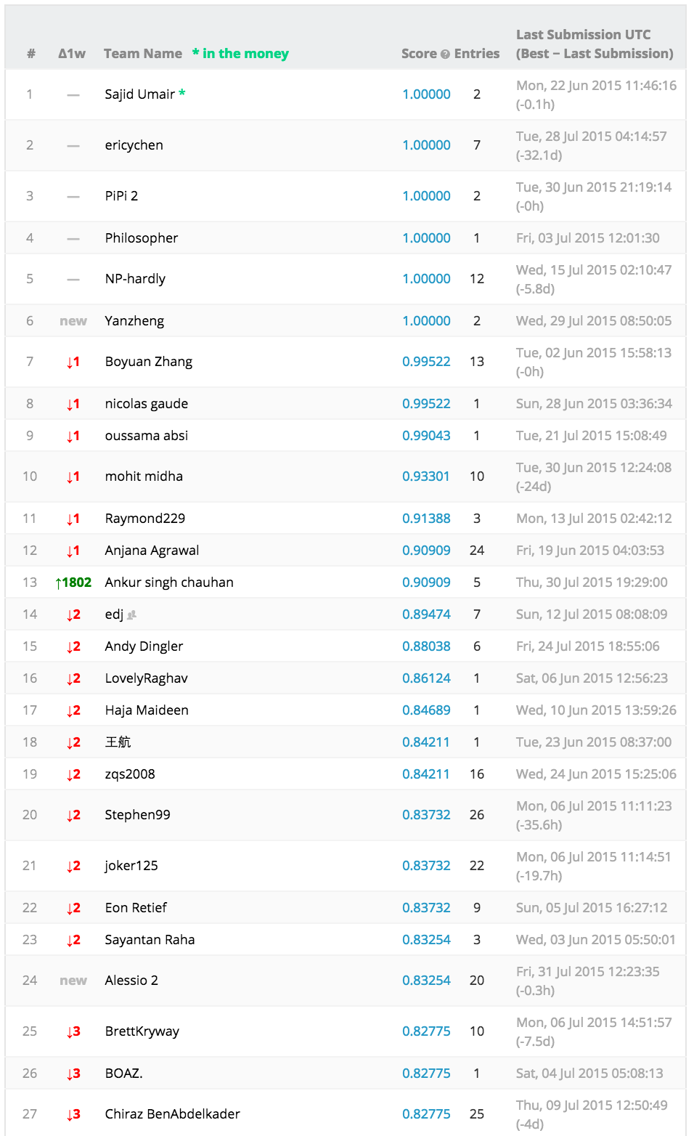
How the Kaggle Leaderboard works
Public train and test data
Secret holdout validation data
Automated scoring
Public leaderboard against test data
Private leaderboard against validation data
Final scoring is giving strong weight to validation data

Slide 8
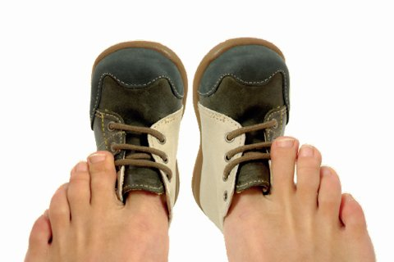
“Overfitting to the leaderboard is a real issue”
Kaggle lets you choose two final submissions
Strong temptation to submit dozens or hundreds of solutions and to pick the ones that are performing “best”
This leads to “manual overfitting”
“The most brutal way to learn about overfitting? Watching yourself drop hundreds of places when a @kaggle final leaderboard is revealed” @benhammer
Image: https://republic.ru/images2/blog_photo_18/2013_06_10/listalka/rastyagivanie.jpg

Slide 9
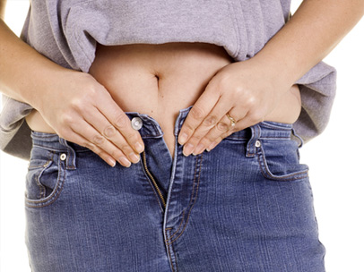
“Overfitting to the leaderboard is a real issue”
Need strong intrinsic measure of performance from train-set alone
k-fold cross-validation
bagging
Possible to use public leaderboard in an intelligent way to glean information or in a weighted manner with CV score
But resist the temptation to just pick the “best” two submissions
Sidenote: the same “manual overfitting” issue applies to hyper-parameters as well, if we are not careful
Image: http://img.sparknotes.com/content/sparklife/sparktalk/tightfitting_Large.jpg

Slide 10

“Simple Models can get you very far”
“I think beginners sometimes just start to “throw” algorithms at a problem without first getting to know the data. I also think that beginners sometimes also go too-complex-too-soon” – Steve Donoho
Start with a simple baseline
Usually “logistic regression” or “random forest” will get you very far. And even “random forest” is far from “simple”
Complex algorithms often run much slower, reducing speed of learning iterations
More model parameter means more risk of overfitting, and more arduous parameter-tweaking
Image: http://www.jeffbullas.com/wp-content/uploads/2013/07/The-Power-of-Simple-Writing.jpg

Slide 11

“Ensembling is a winning Strategy”
“In 8 out of the last 10 competitions, model combination and ensembling was a key part of the final submission”
Improves accuracy at the cost of explanatory value and performance
Do it as a last step
Works best if the models are less correlated and of reasonably high quality; ideally ensemble different algorithmic approaches
Another opportunity for overfitting; what data to train/test them on?
Needs to be use in a disciplined, well-founded manner, not just ad-hoc
Methods:
naive weighting
bagging
AdaBoost
random forest already an ensemble
Image: https://pbs.twimg.com/profile_images/3536053177/89a7cf7df33fea05522399484b7b28f9_400x400.jpeg

Slide 12

“Predicting the right thing is important”
What should I be predicting
correct derived variable
correct loss function
Metric/loss function often given on Kaggle
AUC
Gini
MSE, MAE
Understand what metric underlies your favorite algorithms
But also more subtle understanding of the independent and dependent variables
How to translate the outcome formulation into the correct derived variable; in the face of inconsistent and noisy data
Image: https://theosophywatch.files.wordpress.com/2012/09/seeing-the-future1.jpg?w=500

Slide 13

Miscellaneous
First, build a reusable pipeline and put something on the leaderboard
Understand the subtleties of different algorithms; prefer an algorithm you understand over a shiny new one
Perform feature selection (i.e. random forest), and plug the features back into your “favorite” tool. (redundant variables, some collinearity)
Imputation of missing data (i.e. using clustering)
“Think more, try less”
Choose the right tool for the right job (Excel, SQL, R, Spark, etc.)
Image: http://static.zoonar.com/img/www_repository5/f1/09/f1/8_42d970eeb4f447d441415716a2c7b439.jpg

Slide 14
Thank you

Slide 15
Resources
Thesis – Competitive Machine Learning
expand from blog post: http://blog.kaggle.com/2014/08/01/learning-from-the-best/
http://www.quora.com/What-do-top-Kaggle-competitors-focus-on
http://www.slideshare.net/ksankar/data-wrangling-for-kaggle-data-science-competitions
http://www.slideshare.net/ksankar/oscon-kaggle20?related=1
http://www.slideshare.net/OwenZhang2/winning-data-science-competitions?related=1
http://www.slideshare.net/SebastianRaschka/nextgen-talk-022015
Kaggle Best Practices Youtube
http://blog.kaggle.com/2014/08/01/learning-from-the-best/
Many more Resources and Links: https://gist.github.com/codinguncut/c4359d9bc6f36549b625

